Slide 1
Access 2016 Module 7
Enhancing Forms

Slide 2
Module Objectives
Use Form Design View
Add subforms
Align control edges
Add a combo box for data entry
Add a combo box to find records
Add command buttons
Add option groups
Add tab controls

Slide 3
Use Form Design View (Slide 1 of 2)
Form - a database object designed to make data easy to find, enter, and edit
Create forms by using controls
Design View of a form works with the detailed structure of a form
Purpose of Design View is to provide full access to all of modifications you can make to the form

Slide 4
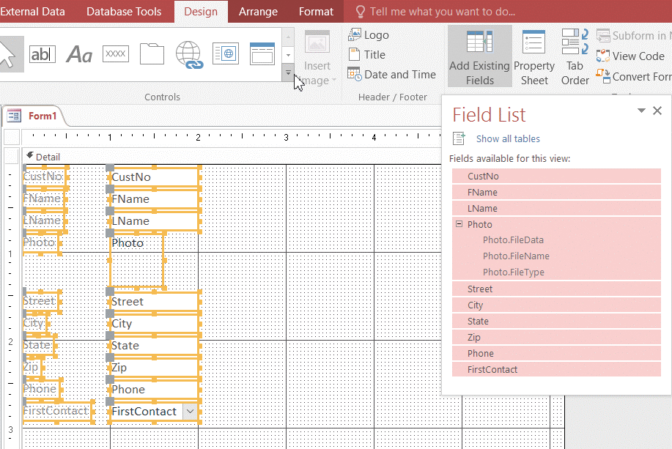
Use Form Design View (Slide 2 of 2)
Adding fields in Form Design View

Slide 5
Add Subforms (Slide 1 of 4)
Subform is a form within a form
The form that contains the subform is called the main form
A main form/subform combination displays the records of two tables that are related in a one-to-many relationship
Main form shows data from the table on the “one” side of the relationship
Subform shows records from the table on the “many” side of the relationship

Slide 6
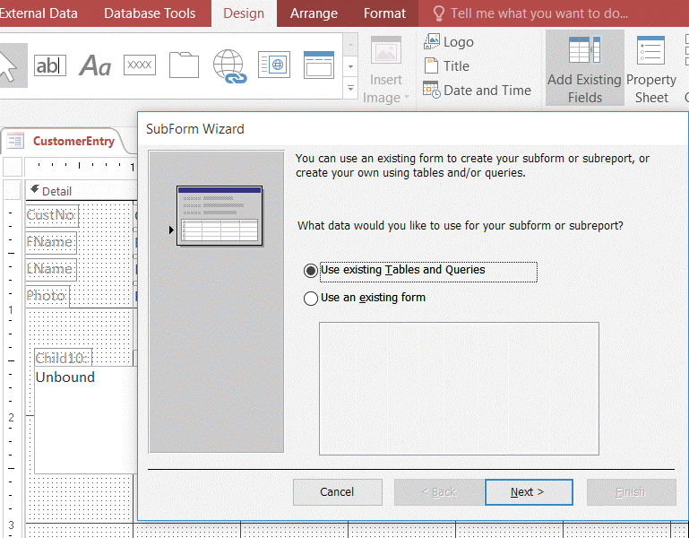
Add Subforms (Slide 2 of 4)
Adding a subform control

Slide 7
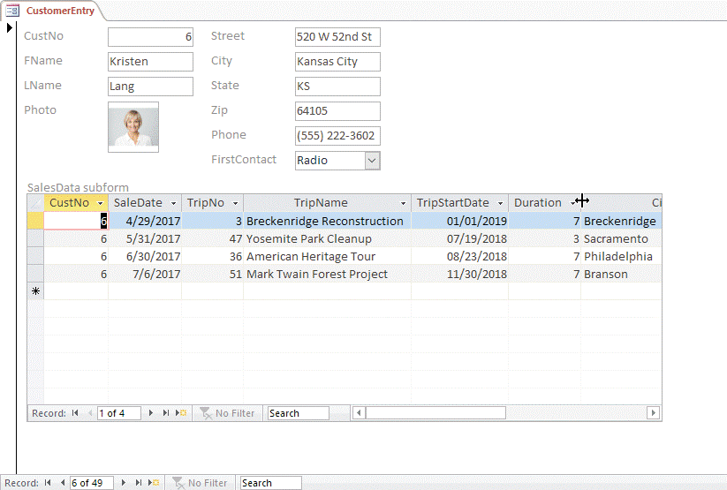
Add Subforms (Slide 3 of 4)
CustomerEntry form and SalesData subform

Slide 8
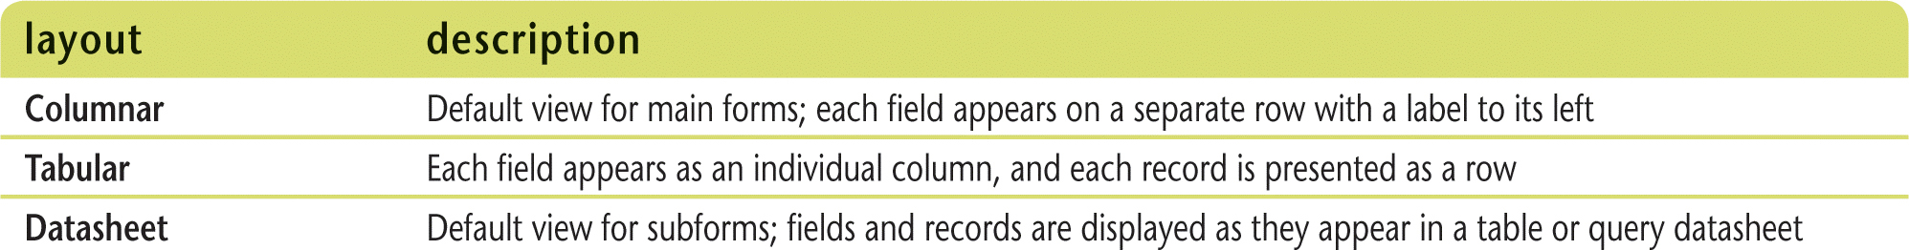
Add Subforms (Slide 4 of 4)
Form layouts

Slide 9
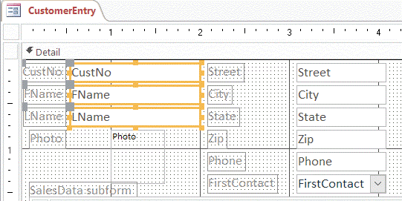
Align Control Edges
Well-designed forms are logical, easy to read, and easy to use
Aligning edges of controls can make a big difference in form usability
To align left, right, top, or bottom edges of two or more controls, use Align button on Arrange tab of Ribbon

Slide 10
Add a Combo Box for Data Entry (Slide 1 of 2)
If a finite set of values can be identified for a field, using a combo box instead of a text box control on a form allows the user to select a value from a list
Both the list box and combo box controls provide a list of values from which the user can choose an entry
Combo box also allows the user to type an entry from the keyboard
“combination” of list box and text box controls
Can create a combo box by
using the Combo Box Wizard
can change an existing text box or list box into a combo box

Slide 11
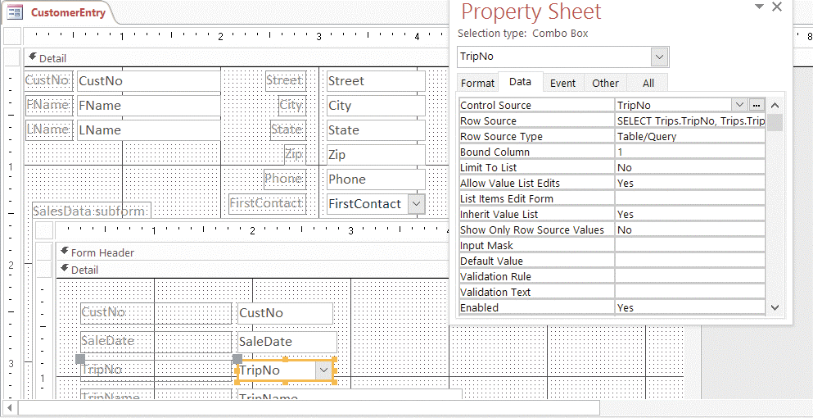
Add a Combo Box for Data Entry (Slide 2 of 2)
Changing the TripNo field to a combo box

Slide 12
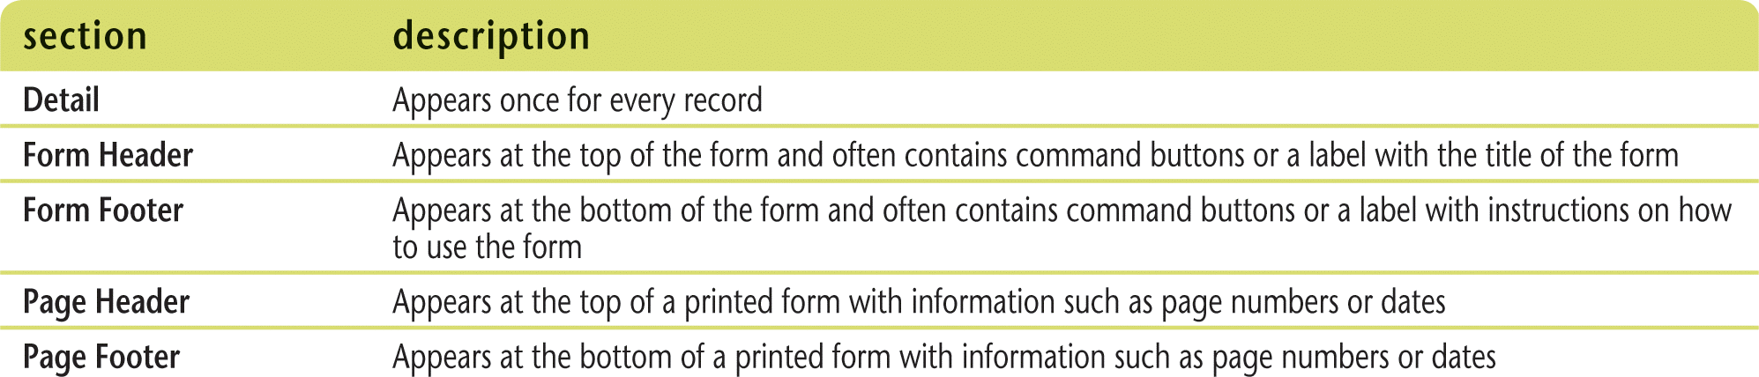
Add a Combo Box to Find Records (Slide 1 of 2)
Can use a combo box to find records
Controls used for navigation are easier to find in Form Header section
Sections determine where controls appear on the screen and print on paper

Slide 13
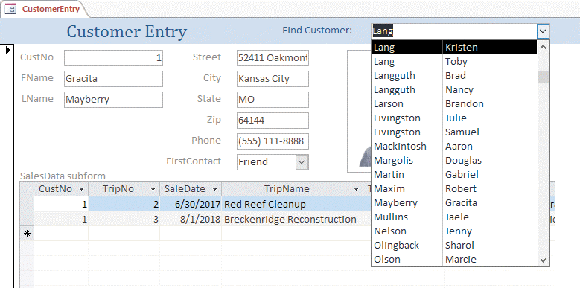
Add a Combo Box to Find Records (Slide 2 of 2)
Using a combo box to find customers

Slide 14
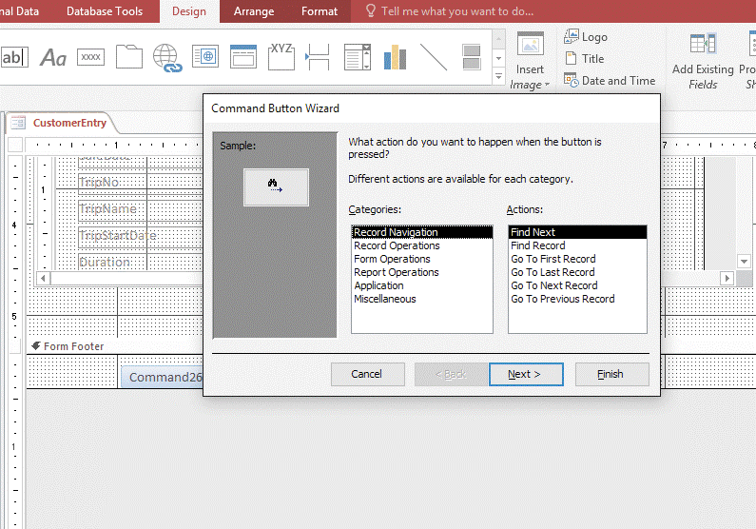
Add Command Buttons (Slide 1 of 2)
Use a command button to perform a common action in Form View
printing the current record, opening another form, or closing the current form
Command buttons are often added to
Form Header or Form Footer sections

Slide 15
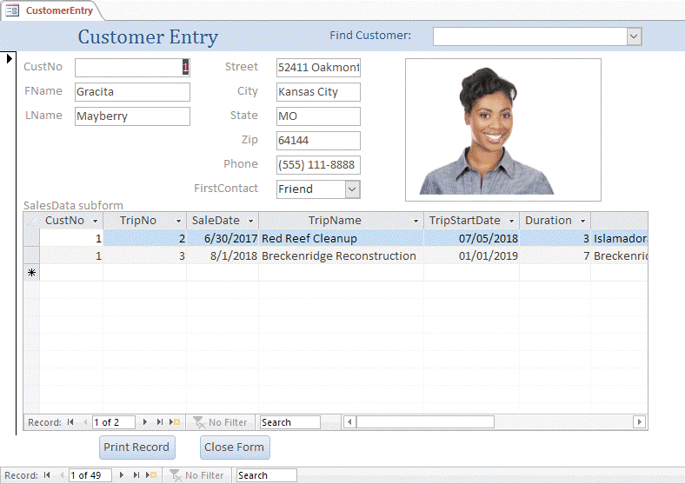
Add Command Buttons (Slide 2 of 2)
Final Customer Entry form with two command buttons

Slide 16
Add Option Groups (Slide 1 of 2)
Option group is a bound control used in place of a text box when only a few values are available for a field
Add one option button control within the option group box for each possible field value
Option buttons within an option group are mutually exclusive
only one can be chosen at a time.

Slide 17
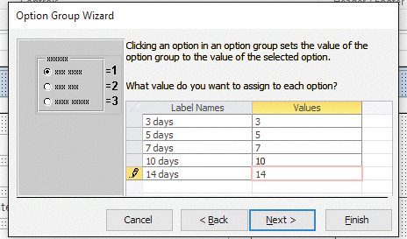
Add Option Groups (Slide 2 of 2)
Option Group Label Names and Values

Slide 18
Add Tab Controls (Slide 1 of 2)
Use tab control to create a three-dimensional aspect to a form so that many controls can be organized and displayed by clicking the tabs
Property Sheet uses tab controls to organize properties identified by categories

Slide 19
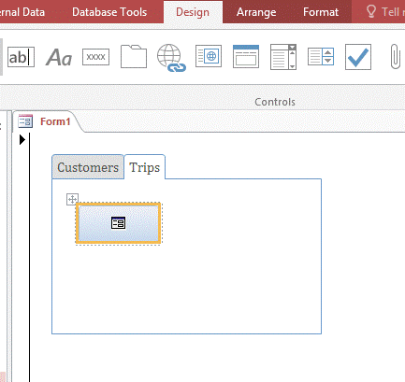
Add Tab Controls (Slide 2 of 2)
Adding command buttons to a tab control

